Slide 1

Web scrapping and sentimental analysis
4/07/2023

Slide 2
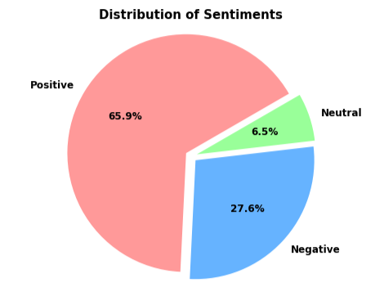
Sentimental Analysis
Around 67% of people share positive reviews.
Only, 6.5% people keep neutral reviews.
However, 28% people shares negative reviews.

Slide 3
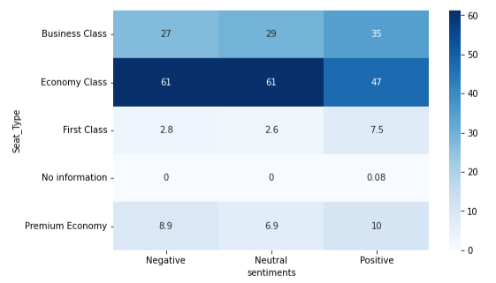
Other Insights
Both negative and positive reviews are high for Economy class.
However, the proportion of negative reviews for Business class, should be this high. The organisation should look after Business Class and the primary reasons for negative reviews.

Slide 4
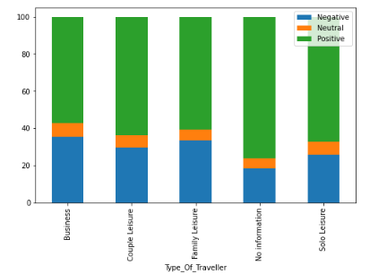
Other Insights
The proportion of negative reviews are high for travellers which travels in family, couple and business leisure.
Around 25% of negative reviews are in each leisure. This should be come down.

Slide 5
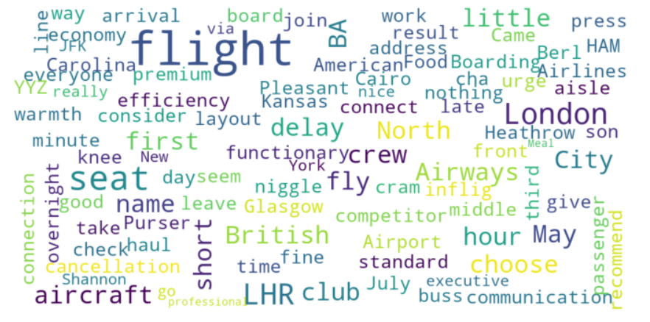
Word Cloud

